Slide 1
Delivering Improving Lives Together
Integrated Community Teams

Slide 2
Overview
Our ambition is to deliver clinically-led, financially sustainable services that are easy to access, and improve people’s experience of care, deliver better outcomes, and address health inequalities. Across Sussex, all health and care organisations have committed to come together to improve the lives of people living across the county.
We want to:
Help local people start their lives well by doing more to support and protect children, young people, and their families.
Help local people to live their lives well by doing more to support people to stay well, and to look after their own health and wellbeing.
Help local people to age well by doing more to support older people to live independently for longer.
Help local people get the treatment, care, and support they need when they do become ill, by doing more to get them to the right service first time.
Help our staff to do the best job they can in the best possible working environment, by doing more to support their health and wellbeing and to promote opportunities which ensure people want to work in health and care services.

Slide 3
Why focus on neighbourhood health?
In Sussex, our current population demographics, people’s daily lives, geography, transport links, community assets and learning from the pandemic, point to planning and designing services at City, district and borough levels, if we are going to truly shift from reactive to proactive care and presentation.
Most people living across Sussex now need more support, care and treatment more often and the services currently available cannot keep up.
This is causing some people to get sicker, experience delays and is putting staff under more pressure.
We need to understand what the reasons behind this are so we can tackle them and make improvements.
We have worked with partners to identify the reasons the health and care system is not effectively meeting these challenges:
How services are arranged and organised: services do not always work seamlessly, which means they can sometimes feel disjointed, slow, and people have to repeat their stories many times.
Not enough emphasis on prevention: there is more that could be done to focus on helping to prevent people becoming ill in the first place.
Not making the best use of digital: we are still not using it in the best possible way and not tapping into all the benefits it could bring.
Limited money and facilities available: there is not enough money available to do everything we ideally would want to do, so we have to get the best value out of the funding we have.

Slide 4
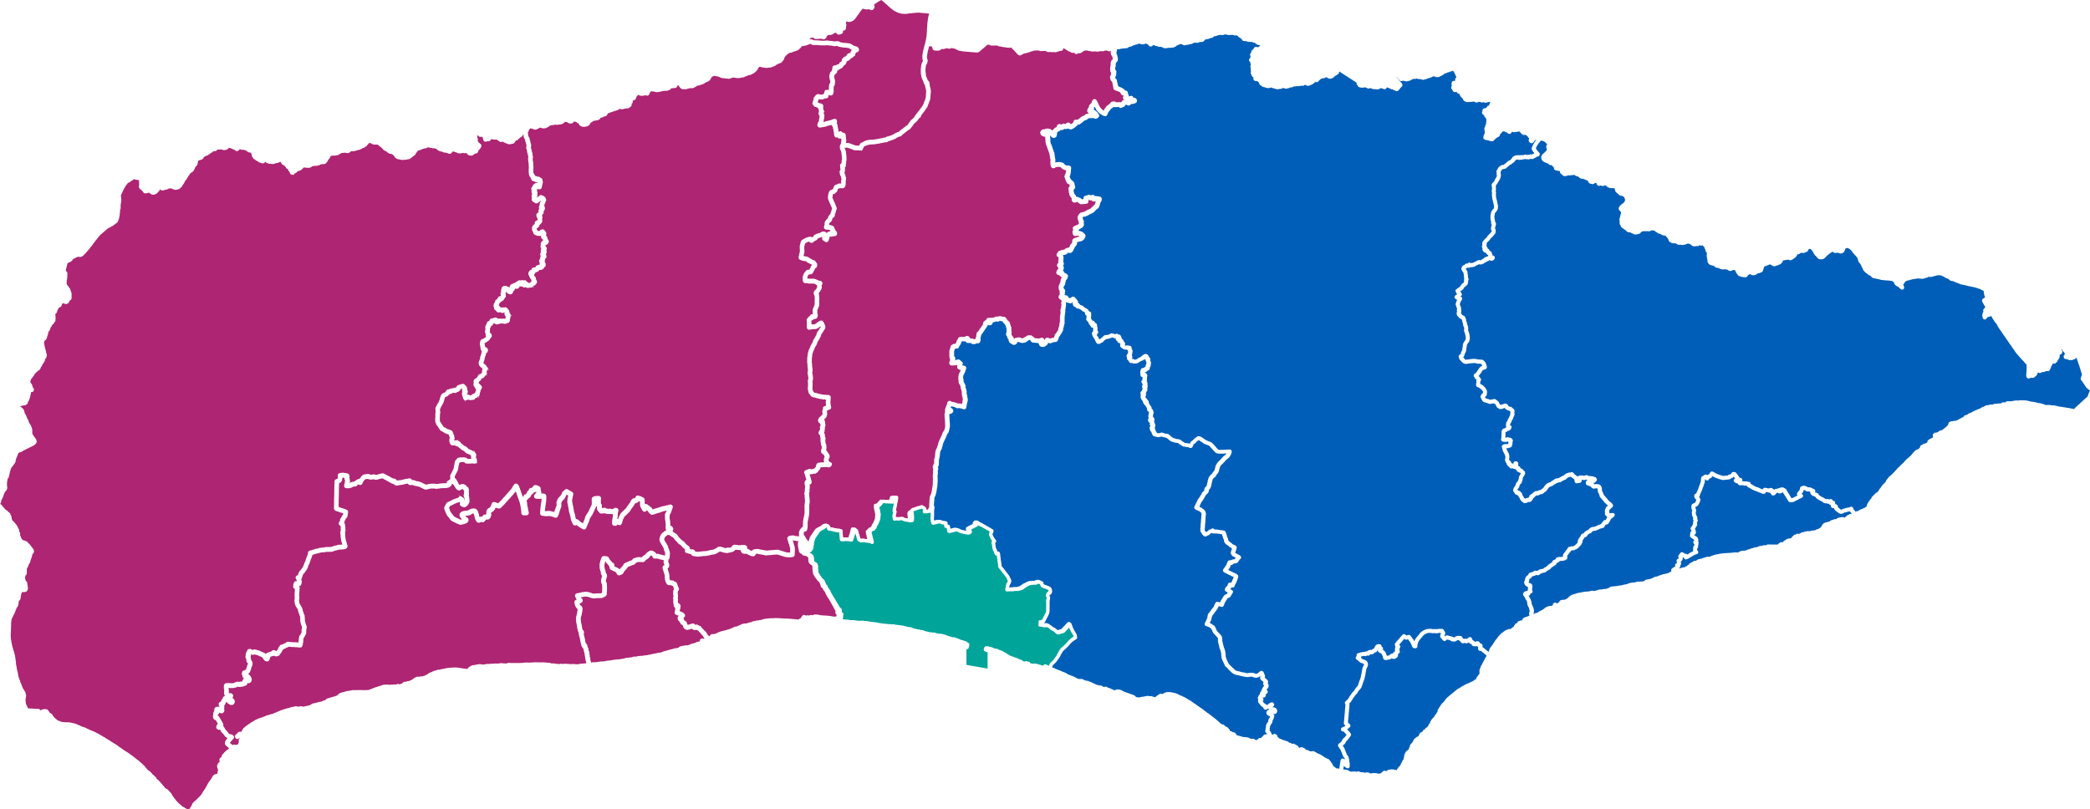
Our Integrated Community Teams (ICTs) geographies
Crawley
Mid
Sussex
Horsham
Wealden
Rother
Chichester
Lewes
Arun
Hastings
Adur
Worthing
Eastbourne
Brighton and Hove
We have agreed 13 ICT footprints across Brighton & Hove, East Sussex and West Sussex. These will serve as the core geographies for planning and delivering services in partnership focussed on local communities and neighbourhoods.
West Sussex
East Sussex

Slide 5
Moving towards a different model of care
The aim is to ensure that services start to bend the curve from reactive service provision to a preventive and proactive care model that meet the needs of the population at neighbourhood levels, empowers communities, enables innovation and transformation such as a digital first approach where appropriate.
The core offer considers physical and mental health together across the different stages of people’s lives:
Emergency care services
Same day care services
Planned care across all settings
Proactive care
Prevention
The shift in the model of care we expect to see will be from reactive to prevention
Neighbourhood First approach Hospital to Community Treatment of Prevention Analogue to Digital

Slide 7
What does this mean for David?
Highest / Ongoing need
David, a retired Armed Forces Veteran, 82, lives alone, feeling isolated, drinks heavily and has several long-term mental and physical health conditions.
His mobility is restricted, he doesn’t go out of his house very often and needs support to travel and get his food shopping. His daughter is increasingly helping to look after him but is struggling with her own mental health and is increasingly finding the pressure too much.
David’s key care needs:
How ICTs will help David:
What difference does that make?
Coordinated support to manage his long-term health issues, address frailty, and plan for end-of-life care.
Social and mental well-being: David needs support for feelings of loneliness and mental health and help with awareness of scams.
Practical and financial help: Assistance with housing problems, financial support, and connections to community services like food banks and health resources (dentist, optician, audiologist).
David will receive help from various services working together, including a digital platform for easy communication among all his care providers, so he only needs to share his story once.
Healthcare teams will regularly check in on David’s health to address any issues early and prevent his condition from worsening.
David will get education and support to manage his health at home, using community resources during times of increased health or social challenges.
David will need fewer GP appointments
He will meet the same professionals, which means they will know him on a human level and better understand his needs
He and his daughter will have access to a range of support and education so he can take better care for himself at home
David will be able to live where he feels comfortable
And he will live the rest of his life with dignity and in the way he decides is best for him

Slide 8
What does this mean for Harpreet?
Whole population
Harpreet, 35, lives in a block of flats, having left her previous housing due to a domestic situation. She lives with her newborn child and two older children. She has type 1 diabetes and used to like going to the gym but had to give it up due to financial hardship. Recently she has been feeling quite anxious, has gained weight and is less keen on going out. She is unable to find work and her feeling of isolation and lack of confidence has impacted on her ability to make friends locally.
Harpreet’s key care needs:
How ICTs will help Harpreet:
What difference does that make?
Social prescribing to link in with relevant support groups
Referral into weight management services and diabetes support services
Mental health support services
Domestic support services
Sexual health advice and support services
Housing and employment support
Post natal support
Breastfeeding support
Financial support
Safeguarding
Harpreet will receive assistance while waiting for assessments, with a single point of access to coordinate services and reduce the need for multiple referrals.
The support extends to the entire family, ensuring a better understanding of their situation and enhancing access to resources for family well-being.
Harpreet will be encouraged to participate in local activities, improving access to community support and resources to enhance overall health and reduce inequalities.
Coordinated care, supported by intelligence and data
More focus on prevention and personalised care
Making every contact count
Self-management and education
Growing confidence to take steps to control own wellbeing and outcomes
Greater knowledge of where to access community support and activities
Better relationships
Harpreet will engage with the system prior to admission/GP contact

Slide 9
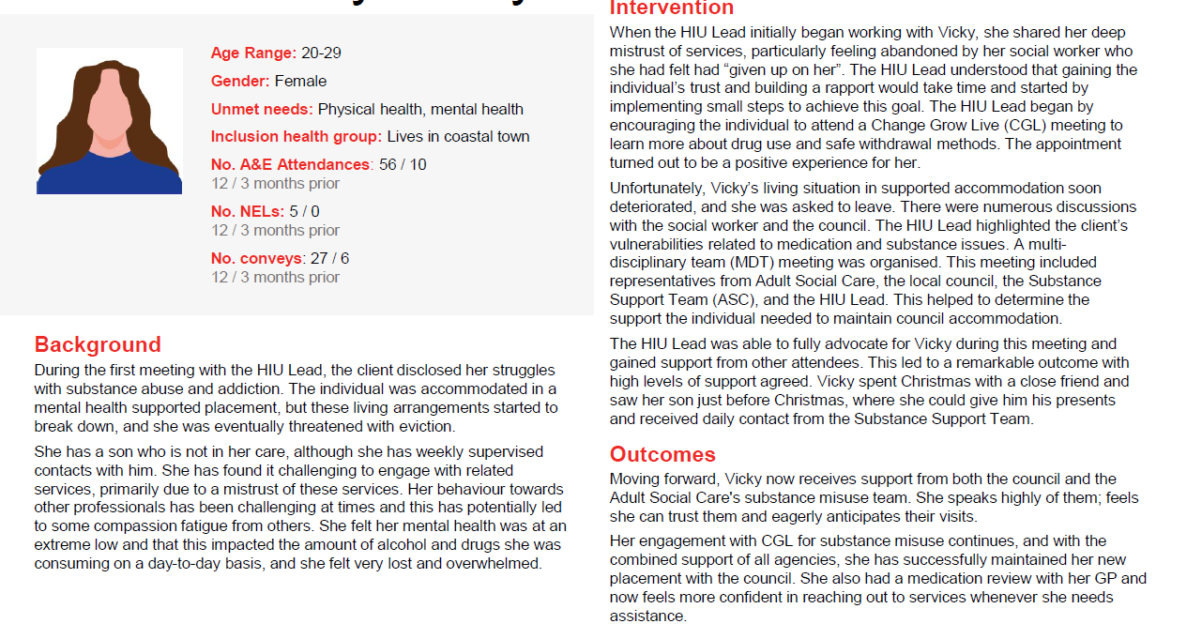
What does this mean for Vicky?
Highest Needs - High Intensity User (HIU) Service
Harpreet’s key care needs:

Slide 10
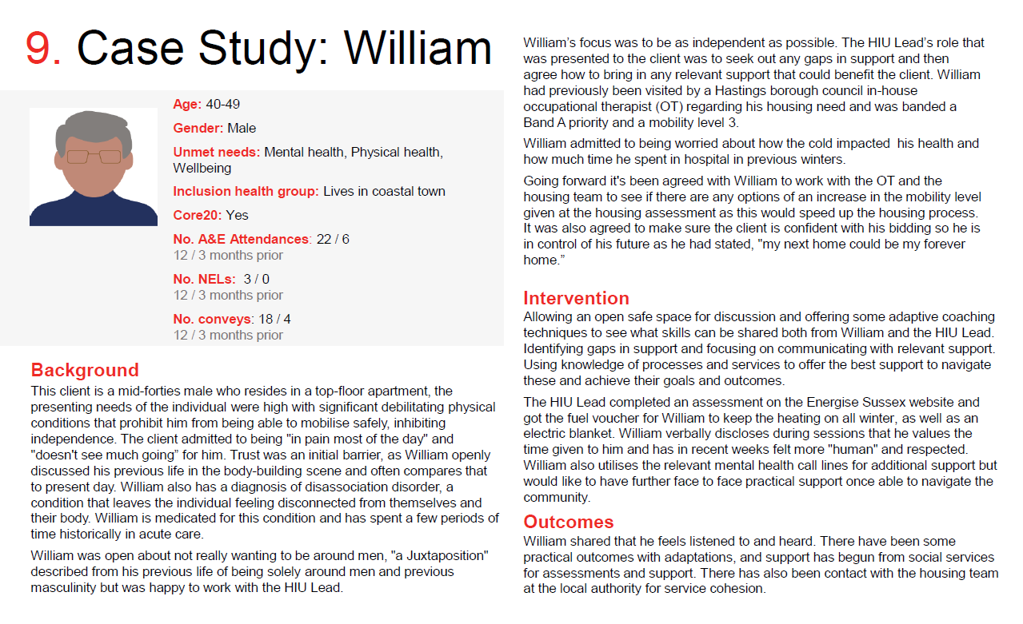
What does this mean for William?
Highest Needs- High Intensity User (HIU) Service
Harpreet’s key care needs:

Slide 11
What does this mean for Glenn?
Highest Needs- High Intensity User (HIU) Service

